Slide 1
Chapter 4a: VLANs (I)
Routing & Switching
Notes:
Cisco Networking Academy program
Routing & Switching
Chapter 3: VLANs

Slide 2
Chapter 3
3.1 VLAN Segmentation
3.2 VLAN Implementation
Notes:
Chapter 3

Slide 3
Chapter 3a: Objectives
Explain the purpose of VLANs in a switched network.
Analyze how a switch forwards frames based on VLAN configuration in a multi-switched environment.
Configure a switch port to be assigned to a VLAN based on requirements.
Configure a trunk port on a LAN switch.
Troubleshoot VLAN and trunk configurations in a switched network.
Notes:
Chapter 3 Objectives

Slide 4
3.1 VLAN Segmentation
Notes:
Cisco Networking Academy program
Routing & Switching
Chapter 3: VLANs

Slide 5
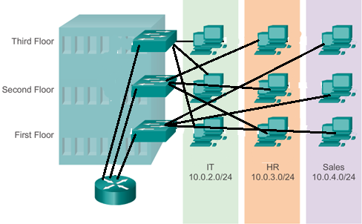
Overview of VLANs
VLAN Definitions
Scenario
You’re designing a network for a company spread over 3 floors of a building.
The company requires 3 subnets: IT, HR and Sales, and each floor has at least 1 PC belong to each of the 3 subnets.
If VLANs don’t exist, how would you do it?
What are some possible problems?
Cabling across floors
Router has limited ports
Notes:
3.1.1.1 VLAN Definitions

Slide 6
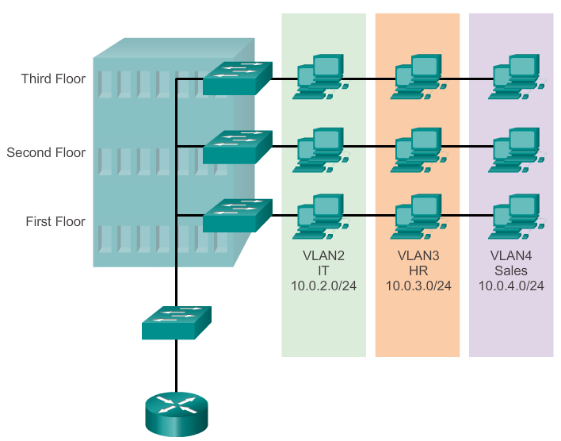
Overview of VLANs
VLAN Definitions
With VLANs, all the PCs on 1 floor can be connected to the switch at that level.
Each switch port can then be configured for that VLAN access only.
Notes:
3.1.1.1 VLAN Definitions

Slide 7
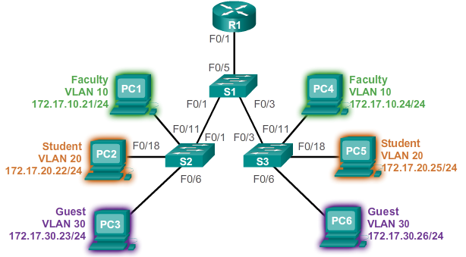
Overview of VLANs
VLAN Definitions
What is a VLAN
It is an independent subnet and broadcast domain.
It allows hosts to be physically separated but yet share the same infrastructure.
Multiple VLANs can be created and can co-exist in the same infrastructure.
It can be named for easy identification
For VLANs to communicate, a router is needed (Chapter 5).
Notes:
3.1.1.1 VLAN Definitions

Slide 8
Overview of VLANs
Benefits of VLANs
Security
Cost reduction
Better performance
Shrink broadcast domains
Improved IT staff efficiency
Simpler project and application management
Notes:
3.1.1.2 Benefits of VLANs

Slide 9
Overview of VLANs
Benefits of VLANs
Security
  Groups with sensitive data can be separated from the rest of the network. Example, computers on VLAN 10 are separated from traffic on VLAN 20.
Cost reduction
  Reduced need for expensive network upgrades and efficient use of existing bandwidth and uplinks.
Notes:
3.1.1.2 Benefits of VLANs

Slide 10
Overview of VLANs
Benefits of VLANs
Better performance
  Divides flat Layer 2 networks into multiple logical workgroups (broadcast domains) reducing unnecessary traffic on the network and boosts performance.
Shrink broadcast domains
Improved IT staff efficiency
Simpler project and application management
Notes:
3.1.1.2 Benefits of VLANs

Slide 11
VLANs in a Multi-Switched Environment
Controlling Broadcast Domains with VLANs
A VLAN is a broadcast domain of its own.
A broadcast frame sent by a device in a specific VLAN is forwarded within that VLAN only thus limiting the reach of the broadcast frame and their impact in the network.
Notes:
3.1.2.2 Controlling Broadcast Domains with VLANs

Slide 12
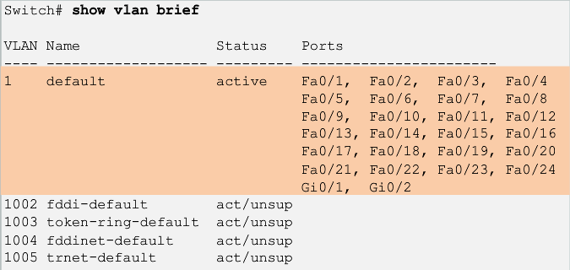
Overview of VLANs
Types of VLANs
Data VLAN
Default VLAN
Native VLAN
Management VLAN
Voice VLAN
Notes:
3.1.1.3 Types of VLANs

Slide 13
Overview of VLANs
Types of VLANs
Data VLAN
  Data VLANs carry user-generated traffic and are used to separate the network into groups of users.
  Voice and management traffic should not be on data VLANs and are usually separated into other VLANs.
Default VLAN
  All switch ports are part of the default VLAN in a default switch configuration (same broadcast domain).
  VLAN 1 is the default
  VLAN and cannot be
  renamed or deleted.
Notes:
3.1.1.3 Types of VLANs

Slide 14
Overview of VLANs
Types of VLANs
Native VLAN
  Links between switches are known as trunk links and the ports are known as trunk ports. Trunk links carry traffic across switches from multiple VLANs by tagging the VLAN ID to the traffic.
  But some legacy LAN traffic may not have any VLAN ID (untagged and doesn’t belong to any pre-defined VLAN). Such traffic are placed on the native VLAN.
  More on trunk links and trunk ports later in the chapter.
Management VLAN
  Network management traffic to access and configure network devices such as switches and routers.
Voice VLAN
  The voice VLAN is for IP voice traffic from IP phones.
Notes:
3.1.1.3 Types of VLANs

Slide 15
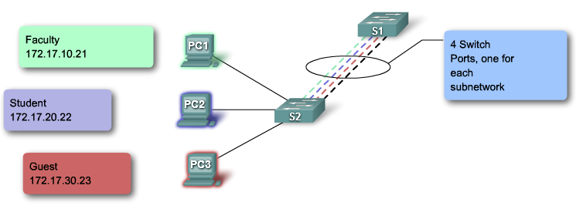
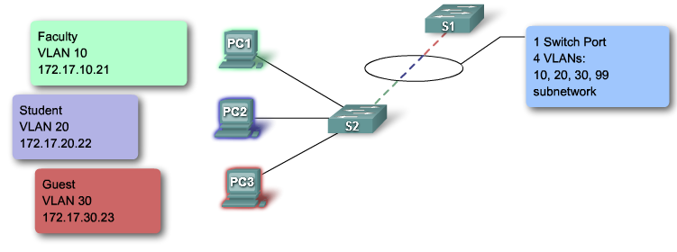
VLANs in a Multi-Switched Environment
VLAN Trunks
A trunk is a point-to-point link between two network devices that carries more than 1 VLAN
Without trunks
With a trunk

Slide 16
VLANs in a Multi-Switched Environment
VLAN Trunks
A VLAN trunk link connects 2 network devices together.
A VLAN trunk carries traffic from one VLAN or more.
A VLAN trunk is usually established between switches so that devices in the same VLAN can communicate, even if physically connected to different switches.
How does a switch know what VLAN a frame belongs to when it reaches the other end of the trunk link?
  Answer: IEEE 802.1q frame tagging
Notes:
3.1.2.1 VLAN Trunks

Slide 17
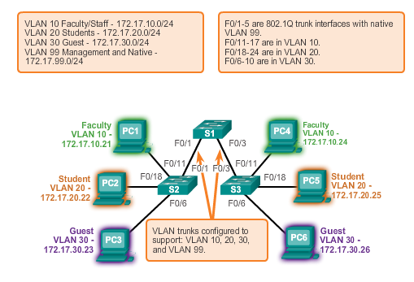
VLANs in a Multi-Switched Environment
VLAN Trunks (cont.)
Notes:
3.1.2.1 VLAN Trunks

Slide 18
VLANs in a Multi-Switched Environment
Tagging Ethernet Frames for VLAN Identification
Frame tagging is the process of adding a VLAN identification header to a frame before transmitting the frame through a trunk link.
It is done so that the frame can be identified to the correct VLAN when it reaches the other end of the trunk link.
A switch tags a VLAN ID to the frame before placing it into trunk link.
On arrival, the other switch reads and removes the tag before forwarding the frame through its non-trunk ports for that VLAN.
Notes:
3.1.2.3 Tagging Ethernet Frames for VLAN Identification

Slide 19
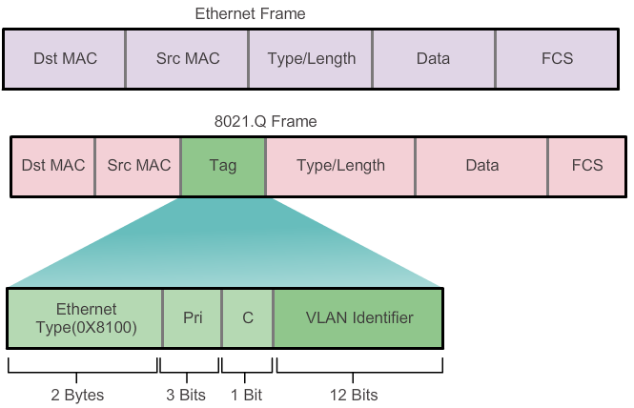
VLANs in a Multi-Switched Environment
Tagging Ethernet Frames for VLAN Identification
Notes:
3.1.2.3 Tagging Ethernet Frames for VLAN Identification

Slide 20
VLANs in a Multi-Switched Environment
Native VLANs and 802.1Q Tagging
Frames that do not have any VLAN ID belong to the native VLAN.
These frames remain untagged and are placed in the native VLAN when forwarded.
In Cisco switches, the native VLAN is VLAN 1, by default.
Notes:
3.1.2.4 Native VLANs and 802.1Q Tagging

Slide 21
Chapter 4a: Summary
This chapter:
Introduced VLANs and their types
Described the connection between VLANs and broadcast domains
Discussed IEEE 802.1Q frame tagging and how it enables differentiation between Ethernet frames associated with distinct VLANs as they traverse common trunk links.
Notes:
Chapter 3 Summary

